Slide 1
Version Control using Git + GitHub
BC Stats Workshop
May 23, 2024
Notes:
Housekeeping
Territorial Acknowledgment
Introductions – Facilitator, Instructors, each other (in the Chat)

Slide 2
Territorial Acknowledgement

Slide 3
Housekeeping
Best practices for learning virtually
Cameras on
Microphones on mute
Getting disconnected
What to do with questions?
Live coding event – not being recorded
Materials availability: https://bcgov.github.io/ds-intro-to-git/
Our request: be fully present
Our presenters: all kinds of awesome

Slide 4
Workshop Code of Conduct
We aim to make this a welcoming and supportive environment for everyone, regardless of background
We encourage respectful discussion and questions throughout the course
Be fully present and engaged during the session (that email can wait!)
(Standards of Conduct for BC Public Service employees)
Notes:
Include talk about how teaching virtual is hard – never taught this one before virtually (have taught variants before) – stick with us!

Slide 5
To Code Along: Installation & Set Up
Install Git (comes with Git Bash): https://git-scm.com/download/win
Configure Git: follow these steps
Create GitHub account (can do over break if needed)
Log-in
Set-up 2MFA
Create a Personal Access Token
https://bcgov.github.io/ds-intro-to-git/pre-workshop/software-install.html
Notes:
To code along, you need software and account set up.

Slide 6
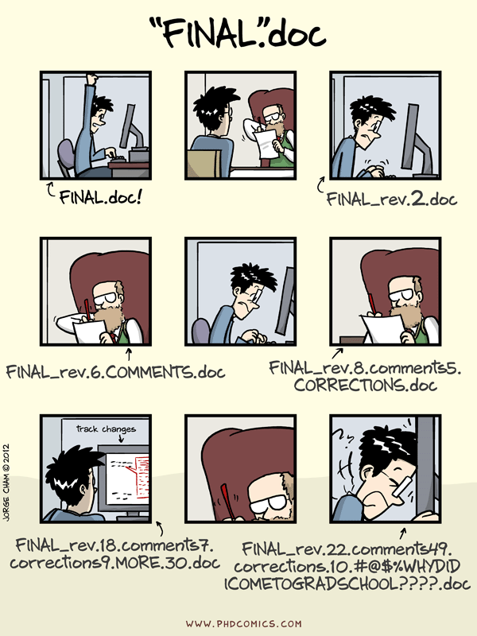
https://phdcomics.com/comics.php?f=1531
Notes:
We’ve all been in this situation before: it seems ridiculous to have multiple nearly-identical versions of the same document – either by yourself or spread around among colleagues.
It’s difficult to tell the difference between files, and what was changed when, by whom, and why?

Slide 7
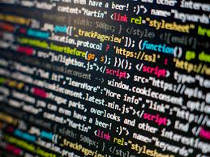
What about code?
BC Stats has A LOT of source code that make:
aggregate / “tidy” data tables
figures/plots & maps
PDF reports
dashboards & applications
prediction models
provincial statistics
https://commons.wikimedia.org/wiki/File:Programming_code.jpg
Notes:
Same and maybe worse with code?

Slide 8
Workshop Outline
Why version control for code?
Setting up our first Git repository
Sharing code on GitHub
Open-source code with BCGov GitHub
Course notes can be found at: https://bcgov.github.io/ds-intro-to-git

Slide 9
Notes:
Why these tools?
Git is one of the most widely used version control tools in the field of data science (and software development)
Git's integration with code hosting platforms like GitHub provides robust collaboration features, including pull requests, issue tracking, and continuous integration/continuous deployment (CI/CD) pipelines.
2014 Exchange Lab created bcgov GitHub

Slide 10
Andy: You know, we should really put our code on GitHub
Steph: Git what?
Andy: GitHub, largest code sharing platform on the web?
Steph: So like Facebook?
## Andy shows Steph website
Steph: I like the octocat…
Notes:
If you have never heard of these tools, that is OK.

Slide 11
Start with WHY?
Version control with Git ensures reproducibility, repeatability, and auditability in data analysis by tracking code changes. Branching and merging facilitate team collaboration, while commit histories and tags enable precise version tracking and reproducibility. Code reviews and detailed commit messages ensure quality and transparency. Integration with CI/CD automates testing and deployment. This structured approach supports efficient collaboration and resilience to team turnover by providing a clear, auditable history of all work. – ChatGPT 🤖

Slide 12
BC Stats Testimonial
"When Lindsay and I worked on creating a Natural Language Processing (NLP) model to code open-ended responses for the BC Demographic Survey, we used GitHub for collaboration. Git allowed us to create branches to independently add or modify code. We reviewed code changes, discussed them, and provided feedback before merging them into the main branch. This process ensured code quality and facilitated knowledge sharing. Each pull request included a description of the changes, which was incredibly helpful in keeping everyone on the same page.” –Kai

Slide 13
https://git-scm.com/about
Notes:
Enter version control. A version control system is a tool that keeps track of changes for us. There are several options; we are going to talk about git. It keeps track of snapshots in time You decide which changes make up each snapshot, and git stores those changes and keeps useful metadata about them.
You store all of your project files in a folder.
All of the files, plus the complete history for all the files in a that folder make up a repository (“repo”).
Repositories can be kept in sync across different computers facilitating collaboration among different people.
From Git website: Git is a free and open source distributed version control system designed to handle everything from small to very large projects with speed and efficiency.
Git is easy to learn and has a tiny footprint with lightning fast performance. It outclasses SCM tools like Subversion, CVS, Perforce, and ClearCase with features like cheap local branching, convenient staging areas, and multiple workflows.

Slide 14
Repository
|── wes-analysis
| |── data
| │ |── wes-results
| │ │ |── wes-results-2019.csv <-- DON'T WORRY, THESE WON'T BECOME PUBLIC!
| │ │ |── wes-results-2020.csv
| │ │ |── wes-results-2021.csv
| │ | |── wes-results-2022.csv
| |── doc
| |── ref
| │ |── references
| │ |── images
| |── plots
| |── code
| |── .git <------------------------ THIS MAKES IT A GIT REPOSITORY!
| | — .gitignore < -------------- FILES listed here are ignored by git (not tracked, e.g., csv files)
Notes:
Git keeps track of snapshots in time – each document or file starts with a base version and then git saves just the changes you made at each step of the way.
You decide which changes make up the each snapshot, and git stores those changes and keeps useful metadata about them.
Each snapshot is called a ‘commit’.
You store all of your project files in a folder.
All of the files, plus the complete history for all the files in a that folder make up a repository (repo).
You can revisit (rewind to) any of those stages, or commits, along the way.

Slide 15
Changes saved sequentially
Commit
Commit
Base Version
Notes:
Git keeps track of snapshots in time – each document or file starts with a base version and then git saves just the changes you made at each step of the way.
You decide which changes make up the each snapshot, and git stores those changes and keeps useful metadata about them.
Each snapshot is called a ‘commit’.
You store all of your project files in a folder.
All of the files, plus the complete history for all the files in a that folder make up a repository (repo).
You can revisit (rewind to) any of those stages, or commits, along the way.

Slide 16
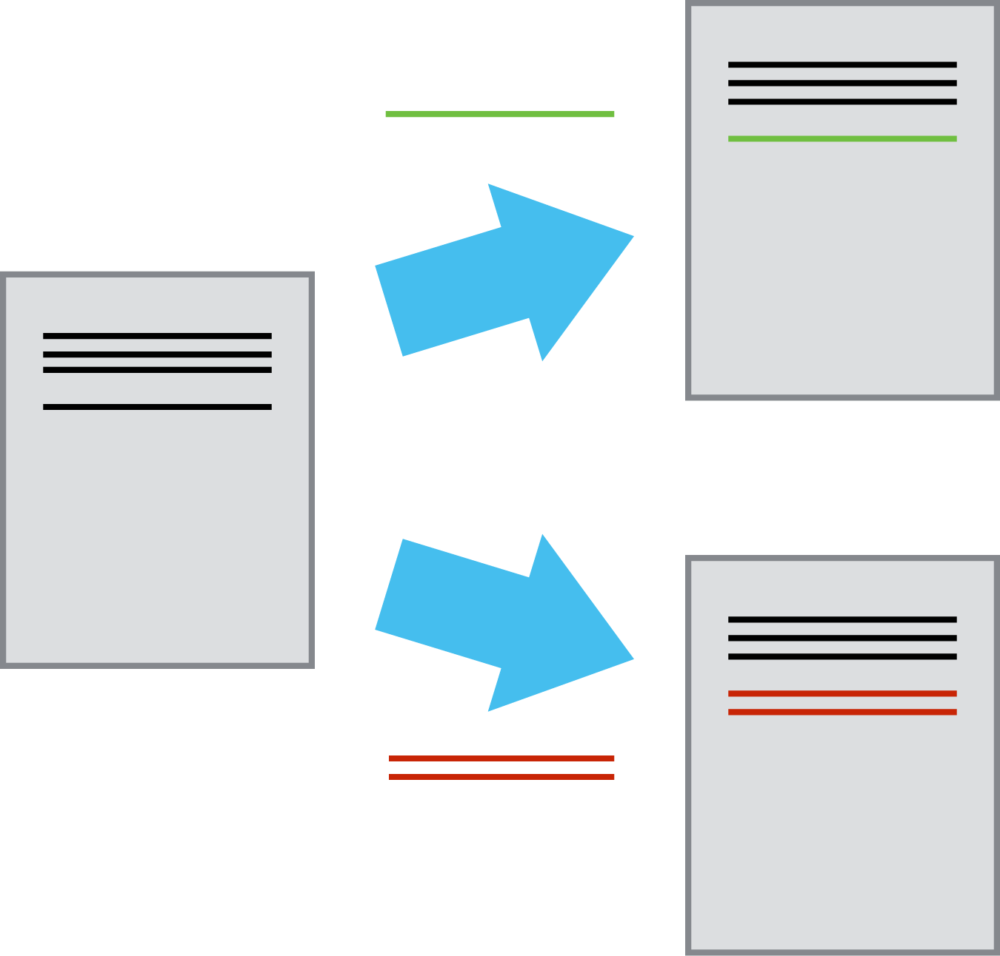
Branching
Notes:
Go off on a different track and work on it independently while keeping the master copy intact.
When it's working you can merge that work back into the original. If not, throw it out.

Slide 17
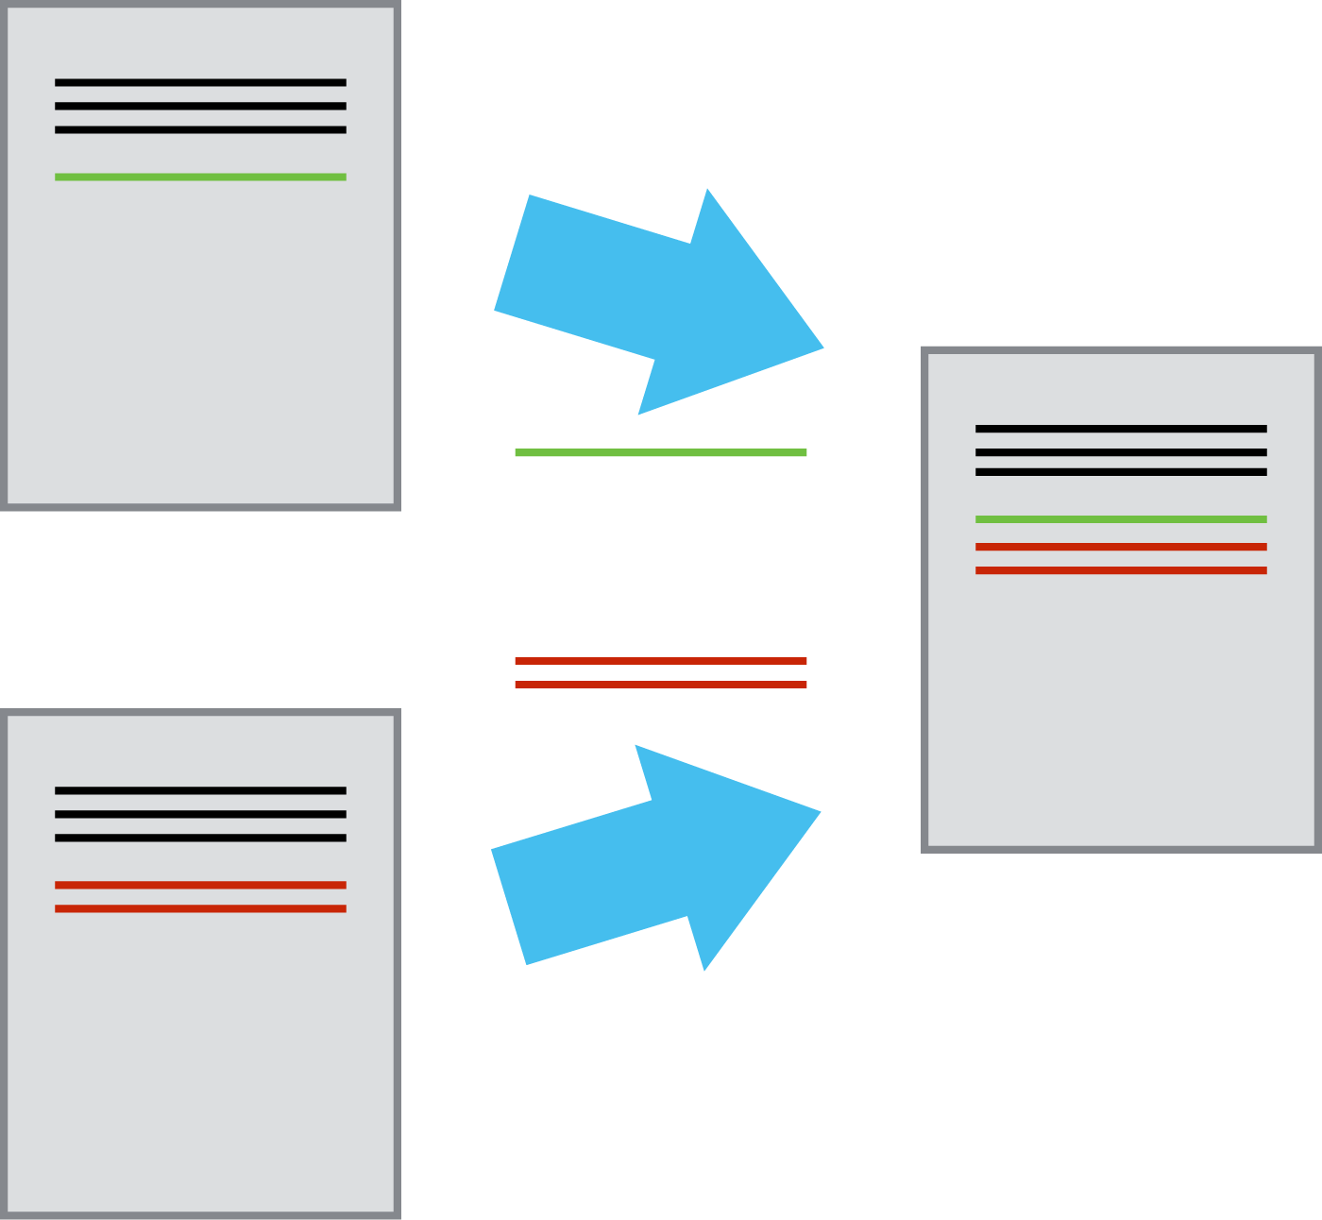
Collaborating
Multiple users: different people work on their own copy
Compare and merge contributions from multiple people
“Remote Copy”
Notes:
Introduce concept of remote
Documents/Repositories can be kept in sync across different computers facilitating collaboration among different people.

Slide 18
Jargon
Repository (repo)
Stage/Add
Commit
Push
Pull
Clone
Branch
Fork
Notes:
Read definition – necessary evil to use the tools

Slide 19
Create our first repository!
Notes:
Let’s make our first repository – YOUR TURN

Slide 20
bash jargon review
$ cd path/to/directory # Go to specified directory - "quotes" are needed if there are spaces
$ cd .. # Go up one directory level
$ mkdir new_directory # Create specified directory
$ ls # List directories and files
$ ls -a # List directories and files, including hidden

Slide 21
git jargon review
$ git init # initiate a repository in the current directory
$ git status # indicate if there are any changes to files
$ git add <filename> # add a new file/change to the staging area
$ git commit –m “commit message” # commit all staged changes to the repository
$ git log # view commit history
$git diff # show changes between commits
$git restore # restore file/s to previous commit

Slide 22
Local Repository
Notes:
Repository is just “your” folder under version control

Slide 23
GitHub
Hosting service for git repositories
Greatly facilitates collaboration
Git: Version Control
+
Hub: Centralized repos &
networking/collaborating
Notes:
GitHub is a platform that hosts Git repositories in the web and provides a web interface to interact with repos.
Main Function is to host the ‘remote’ or main copy of a git repository (project)

Slide 24
Remote
Local
Local
🧑‍💻
👨🏽‍💻
👩🏻‍💻
Local
Notes:
Version control really comes into its own when we begin to collaborate with other people. We already have most of the machinery we need to do this; the only thing missing is to copy changes from one repository to another.

Slide 25
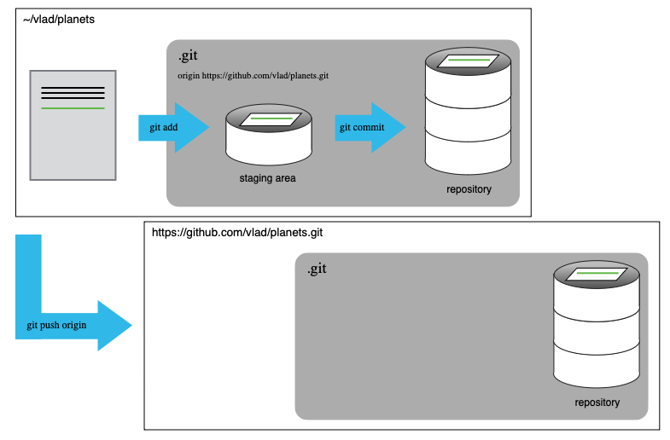
Remote Repository
Notes:
Think of the remote as the “authoritative” version/source/copy

Slide 26
Create your first remote repository!
Notes:
Let’s make our first repository

Slide 27
A Collaborative Workflow
git init
git add mars.txt
git commit –m “first commit”
Original Repository
|── planets
| |── mars.txt
| |── .git
Initial repository set up

Slide 28
A Collaborative Workflow
done on GitHub
git remote add origin <url>
Original Repository
|── planets
| |── mars.txt
| |── .git
GitHub Repository
|── planets
| |── .git
Initial repository set up
Remote repository created & linked

Slide 29
A Collaborative Workflow
git push –u origin main
Original Repository
|── planets
| |── mars.txt
| |── .git
GitHub Repository
|── planets
| |── mars.txt
| |── .git
Initial repository set up
Remote repository created & linked
Local changes pushed to remote

Slide 30
A Collaborative Workflow
git clone <repo-url>
Original Repository
|── planets
| |── mars.txt
| |── .git
GitHub Repository
|── planets
| |── mars.txt
| |── .git
Cloned Repository
|── planets
| |── mars.txt
| |── .git
Initial repository set up
Remote repository created & linked
Local changes pushed to remote
Remote repository cloned by collaborator

Slide 31
A Collaborative Workflow
git add pluto.txt
git commit –m “add pluto”
Original Repository
|── planets
| |── mars.txt
| |── .git
GitHub Repository
|── planets
| |── mars.txt
| |── .git
Cloned Repository
|── planets
| |── mars.txt
| |── pluto.txt
| |── .git
Initial repository set up
Remote repository created
Initial repository set up
Remote repository created & linked
Local changes pushed to remote
Remote repository cloned by collaborator
Collaborator makes additions

Slide 32
A Collaborative Workflow
git push
Original Repository
|── planets
| |── mars.txt
| |── .git
GitHub Repository
|── planets
| |── mars.txt
| |── pluto.txt
| |── .git
Cloned Repository
|── planets
| |── mars.txt
| |── pluto.txt
| |── .git
Initial repository set up
Remote repository created
Initial repository set up
Remote repository created & linked
Local changes pushed to remote
Remote repository cloned by collaborator
Collaborator makes additions
Collaborator updates remote with changes

Slide 33
A Collaborative Workflow
git pull origin main
Original Repository
|── planets
| |── mars.txt
| |── pluto.txt
| |── .git
GitHub Repository
|── planets
| |── mars.txt
| |── pluto.txt
| |── .git
Cloned Repository
|── planets
| |── mars.txt
| |── pluto.txt
| |── .git
Initial repository set up
Remote repository created
Initial repository set up
Remote repository created & linked
Local changes pushed to remote
Remote repository cloned by collaborator
Collaborator makes additions
Collaborator updates remote with changes
Collaborator changes pulled back to original

Slide 34
Ignore data files! .gitignore
Notes:
Also ignore the artifacts (.Renviron, .ipynb, html/ppt/docx, PDFs etc)

Slide 35
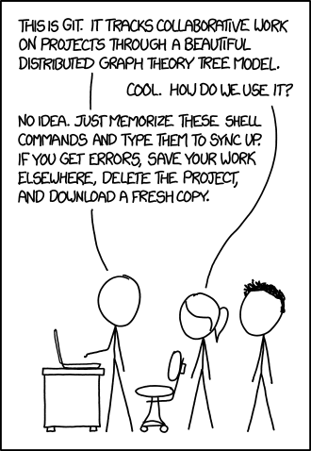
Burn It Down
“This is a highly inelegant, but effective technique for disaster recovery”
- Jenny Bryan (Posit PBC)
https://xkcd.com/1597/
Notes:
Allows fearless experimentation without worrying about breaking your code

Slide 36
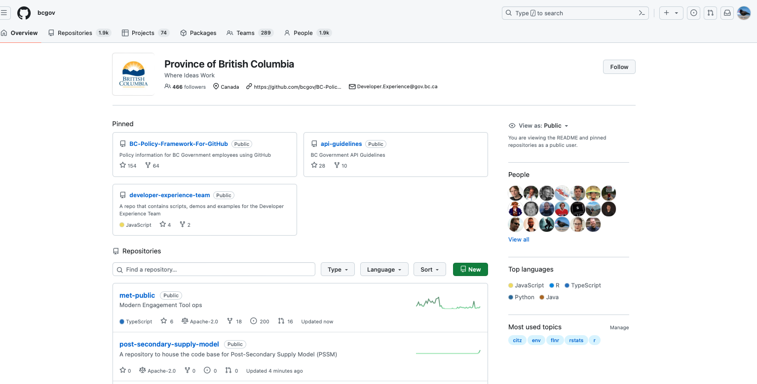
https://github.com/bcgov
Notes:
Efforts and leadership from the OCIO and the BCDevExchange team resulted in a BCGov Org in GitHub, established in early 2014.

Slide 37
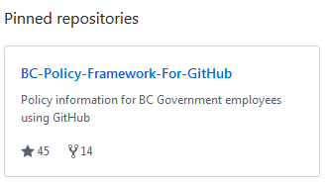
BC-Policy-Framework-For-GitHub
Joining
Opening & Contents of Repositories
Licensing
Privacy, Security, Copyright
Appropriate Use
How to’s
Notes:
(SLH)

Slide 38
Joining
GitHub account with bcgov email address
Enable 2-Factor Authentication
Join relevant repositories as a collaborator or join the BCGov Organization
Notes:
(SLH)

Slide 39
OPEN CODE CHECKLIST
Your Code & GitHub?
New code
Existing code (you, contractor?)
Contributing to other’s code
Privacy
Copyright
Intellectual Property
Security
Notes:
(SLH)
Can my code go into GitHub? Things to consider -- why we have a checklist.
Less steps to start new, but fine to publish too.

Slide 40
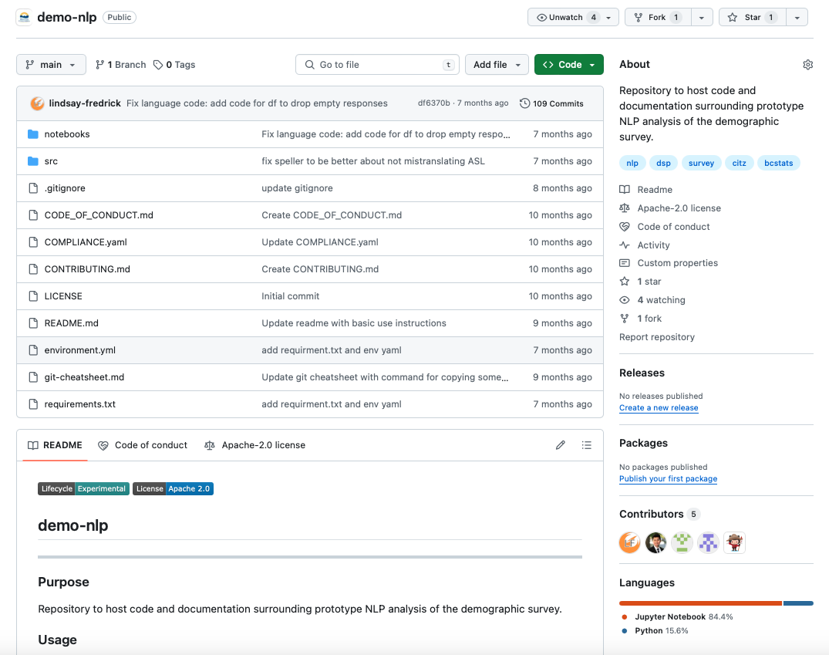
Repo Content
https://github.com/bcgov/demo-nlp
Notes:
(SLH)
3 Mandatory files:
LICENSE
README – what is in this project
Contributing – encourage government employees, public and members of the private sector are encouraged to contribute to the repository and how to do that
To foster a kind, inclusive, cooperative, and harassment-free open source BCGov community -> Optional Code-of-Conduct.
Open Source space in general has had its struggles with conduct and one approach to improving this is establishing clear code of conduct for open source projects. Most often this is a statement around fostering an open, safe, welcoming, and respectful inclusive community for all.

Slide 41
Licensing 1-2-3
BCGov default for code == Apache License 2.0
LICENSE file directly in the repository
2.0 LICENSE boiler-plate to the bottom of your README.md
LICENSE boiler-plate to the comments header of every source code file
Notes:
(SLH)

Slide 42
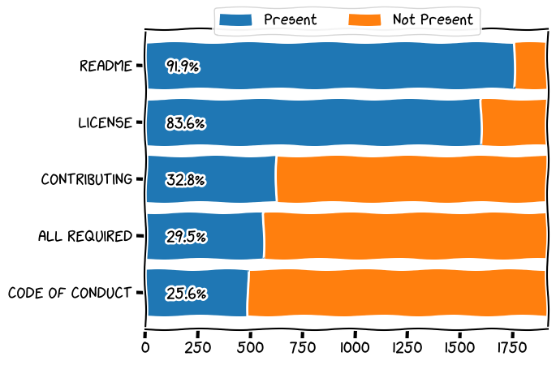
BCGov Org Stats
Notes:
(SLH)

Slide 43
Appropriate Use
e.g. standards of conduct, social media guidelines
Avoid any conflicts of interest
Notes:
(SLH)

Slide 44
"Working in github.com/bcgov" Cheatsheet
https://github.com/bcgov/BC-Policy-Framework-For-GitHub/blob/master/BC-Gov-Org-HowTo/Cheatsheet.md
Notes:
(SLH)
Most of the content in this talk is summarized in a new “Working in BCGov GitHub” cheatsheet
Includes a list of learning resources for Git & GitHub

Slide 45
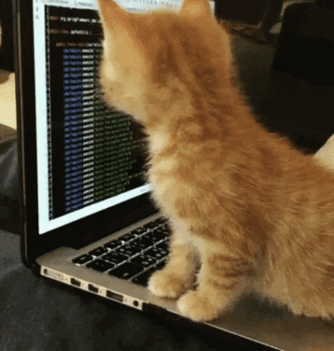
Git from the Command Line
https://gidgid.medium.com/why-you-should-use-git-from-the-command-line-7054150e7eb
https://giphy.com/gifs/cat-kitten-computer-3oKIPnAiaMCws8nOsE
Notes:
If the command line is not your happy place
https://gidgid.medium.com/why-you-should-use-git-from-the-command-line-7054150e7eb

Slide 46
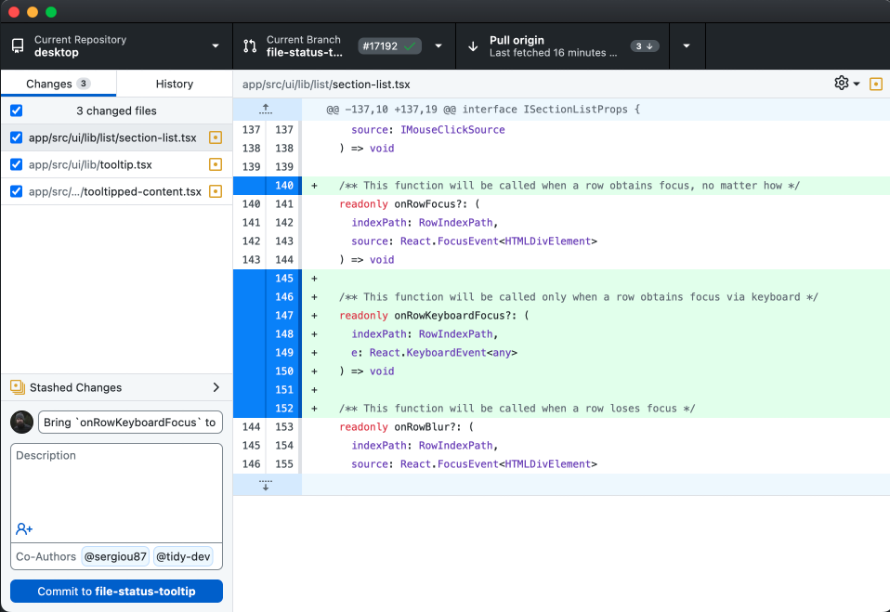
GUIs for Git/Hub: GitHub Desktop

Slide 47
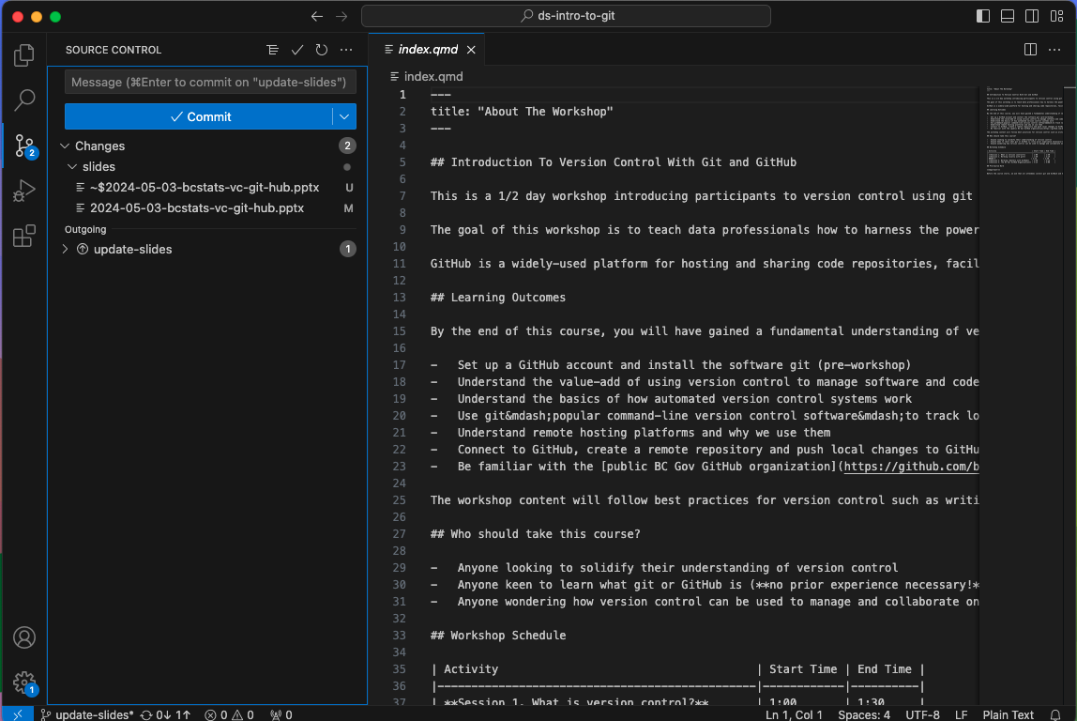
GUIs for Git/Hub: VS Code

Slide 48
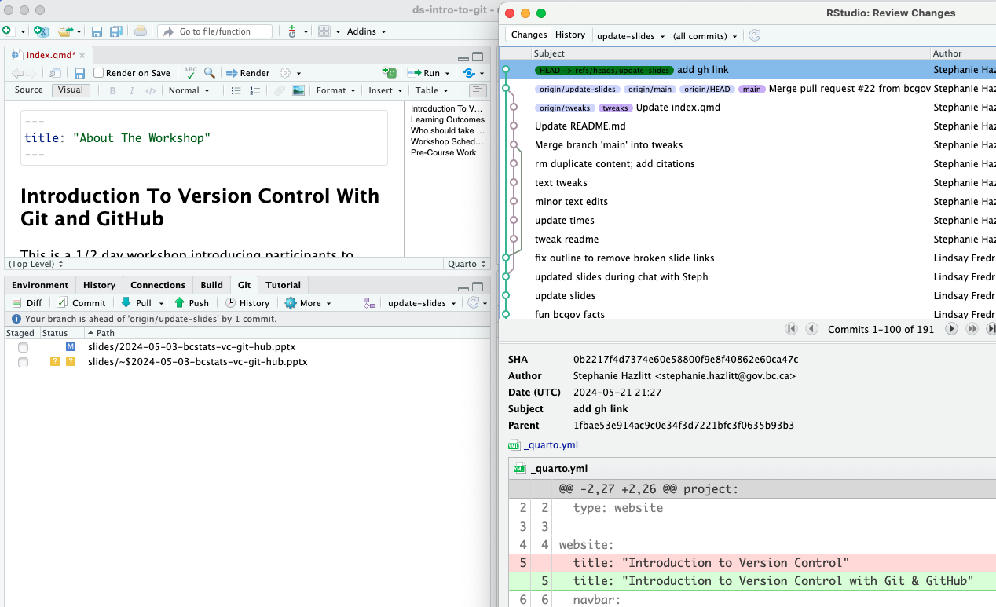
GUIs for Git/Hub: RStudio IDE

Slide 49
Version Control using Git + GitHub
Why put your code under version control 🛟
Git for version control (command line tool) ◼️
GitHub for open source bcgov code
https://bcgov.github.io/ds-intro-to-git/ (based on a lesson from The Carpentries)

